Slide 1

Life-Insurance

Slide 2

Flow of Presentation The Team The Challenge The Process Technology Stack UML diagrams Outputs

Slide 3
The Team
Avisha Jain
Venkatesh Koppisetti

Slide 4
The Challenges
Developing the Full stack Life-Insurance Application, which would ease the process of selecting, buying and maintaining the plans brought by clients.
The Admin will be the responsible for the management of employees and the agents and for adding new plans.
Employee and agent will be taking care of all the Client-side functionality.

Slide 5
The Process
• Identify the Entities
• Control Flow Diagram
• Deciding Role
• Creating Class Diagram
• Building REST API
• Making Front-End Modules
•Integration of Frontend and database using API
• Testing features.

Slide 6
Technology Stack
Frontend
React
Material UI
Backend
Node JS
Express
JSON web token
Database
Mongo DB

Slide 7
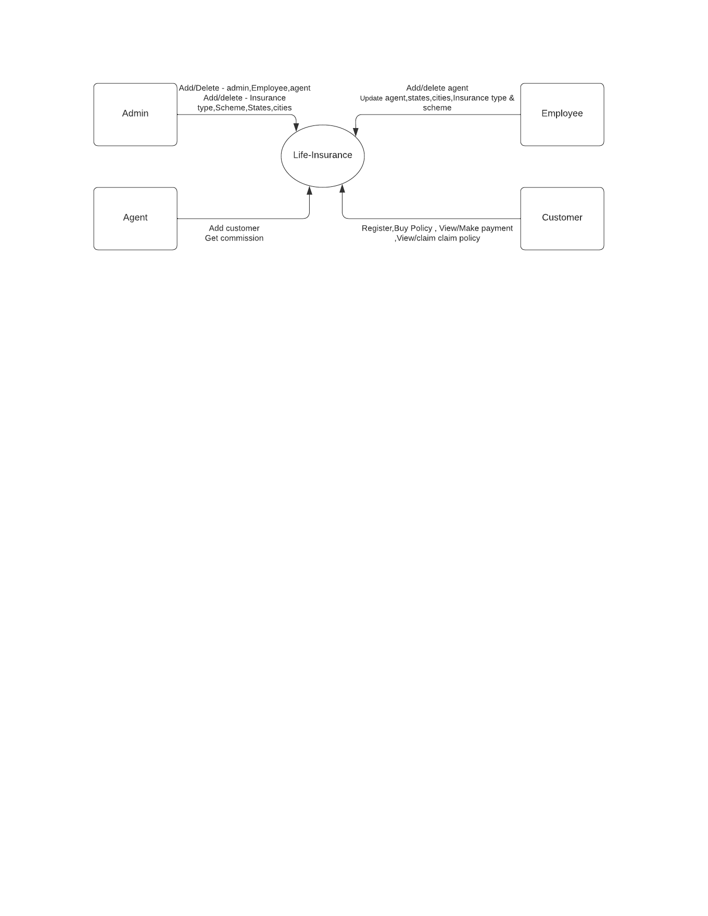
Control Flow Diagram

Slide 8
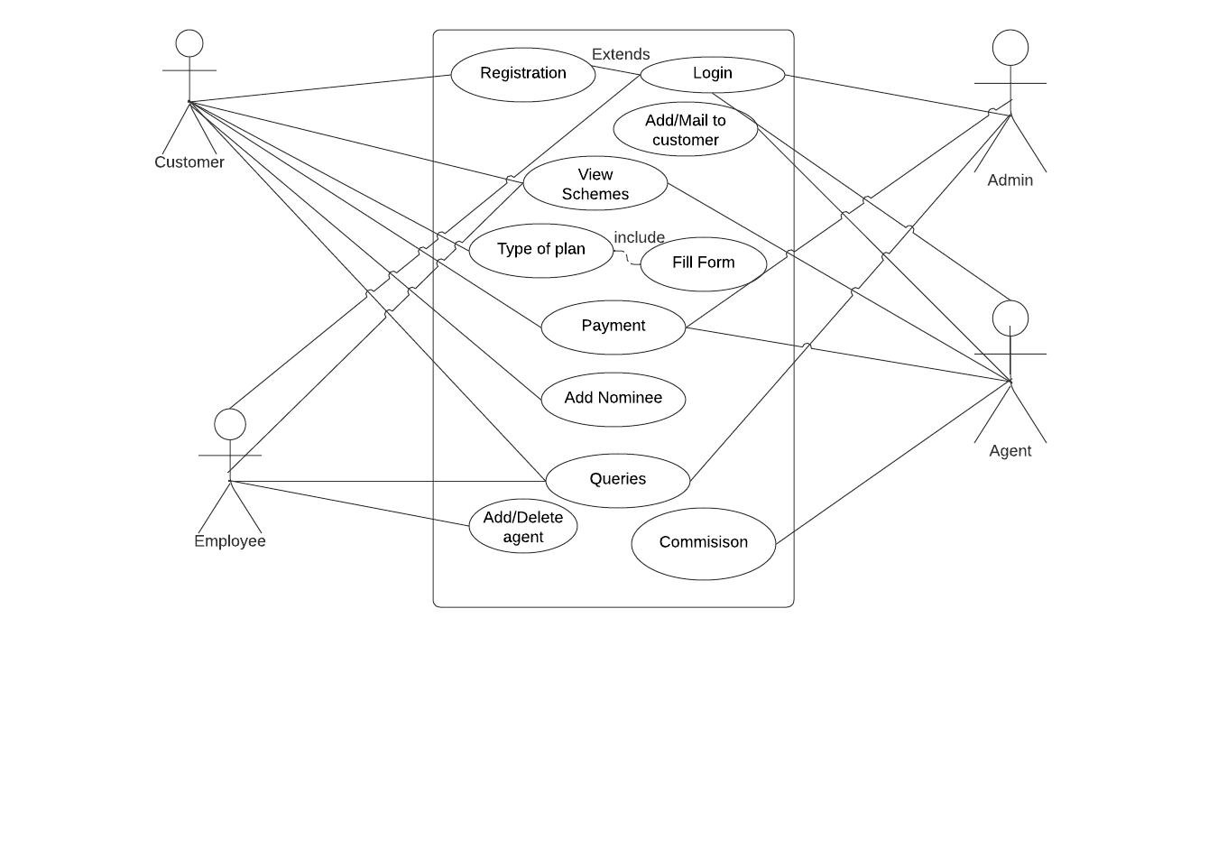
Use Case Diagram

Slide 9
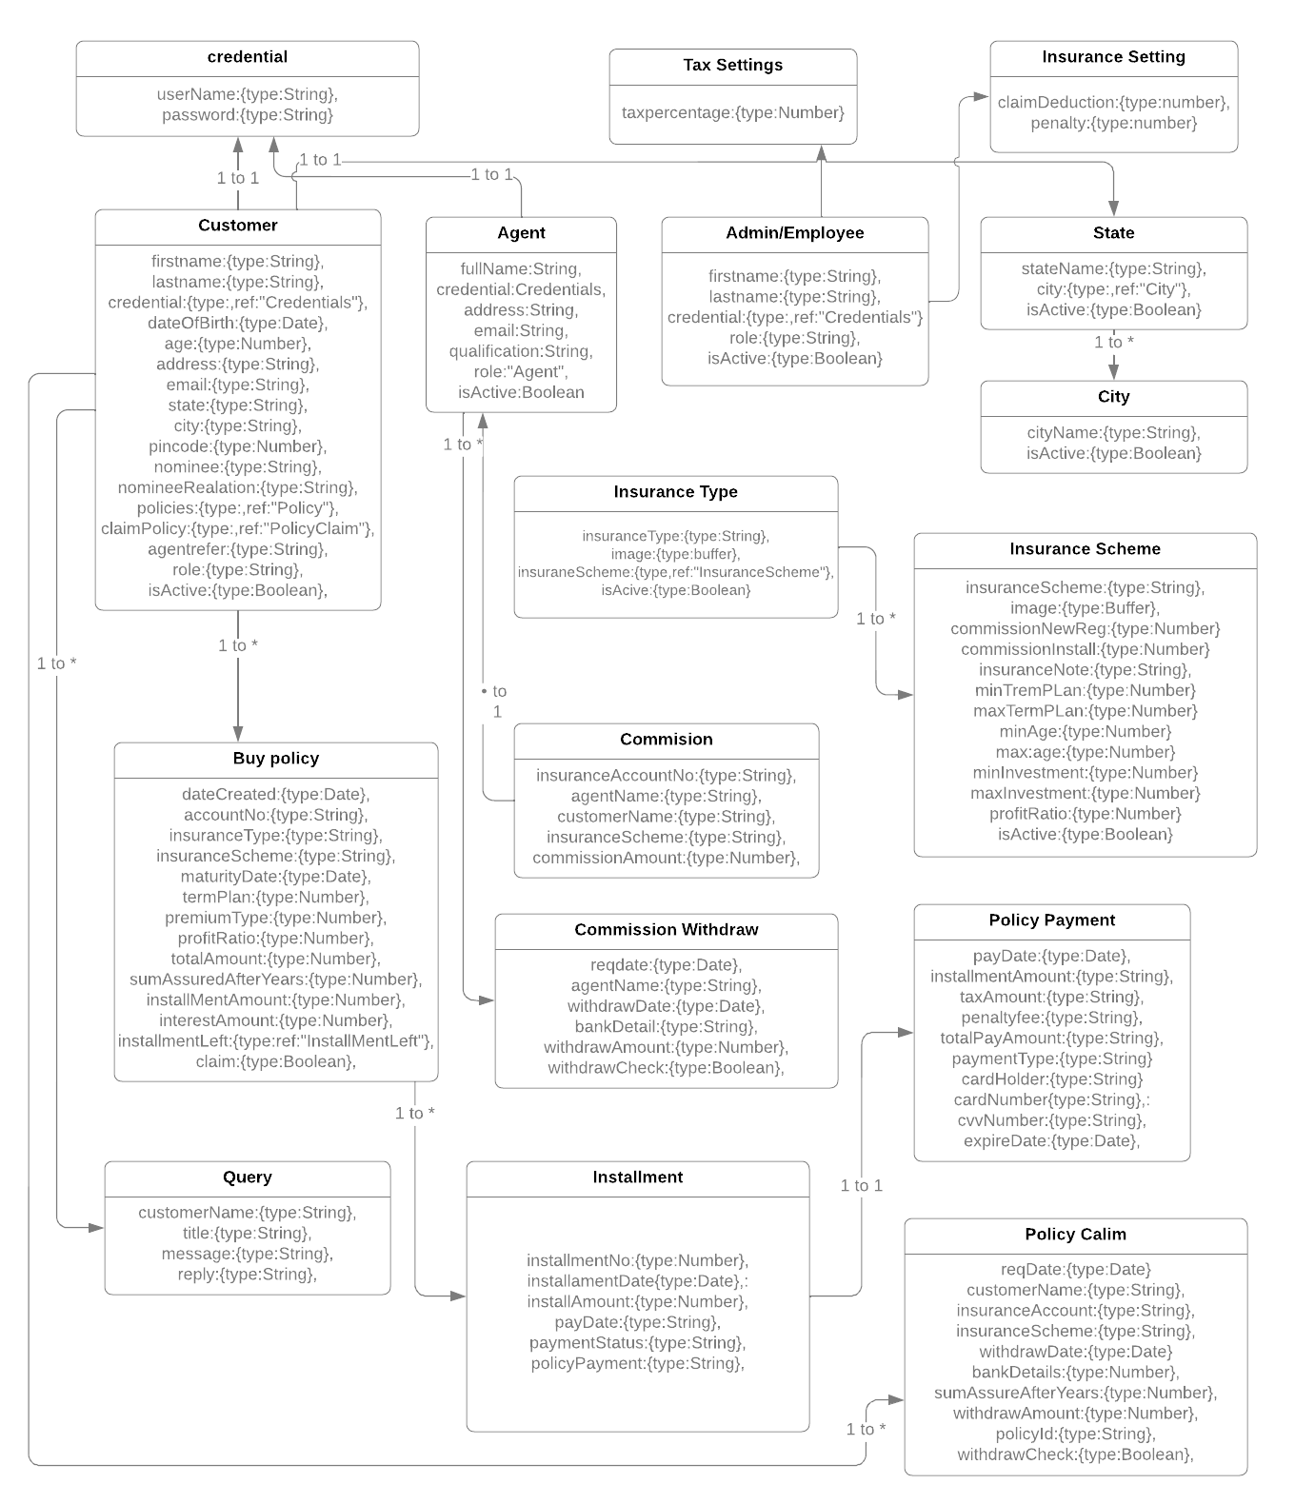
Class Diagram:

Slide 10
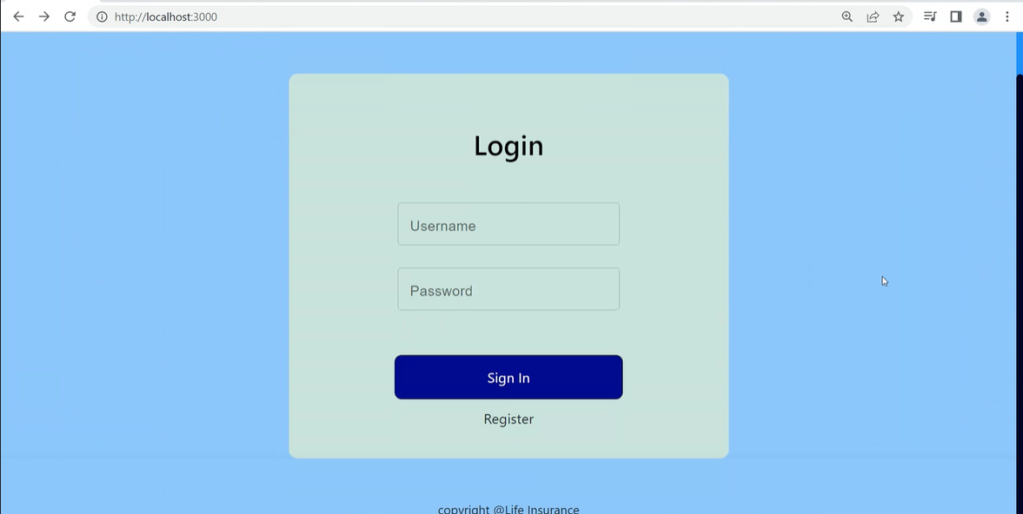
Outputs
Login Page

Slide 11
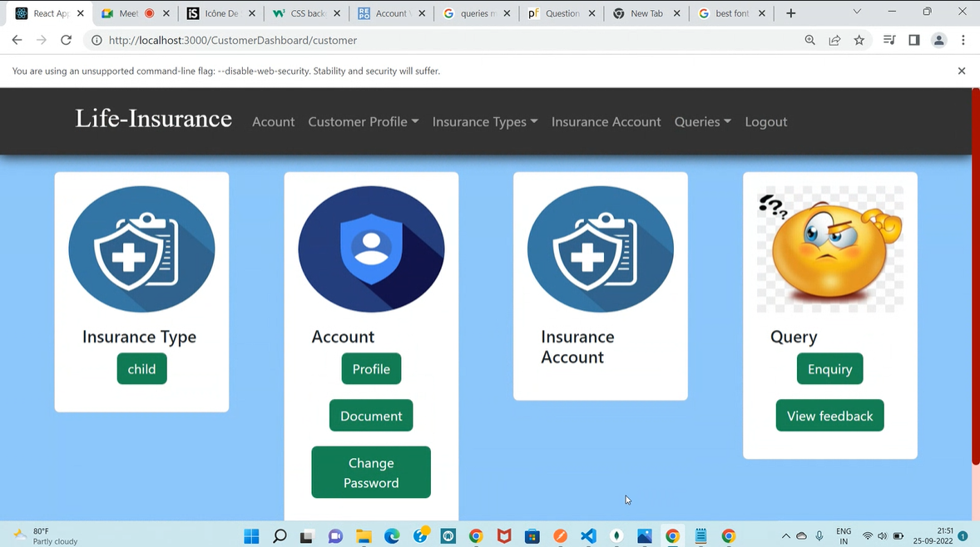
Customer Dashboard

Slide 12
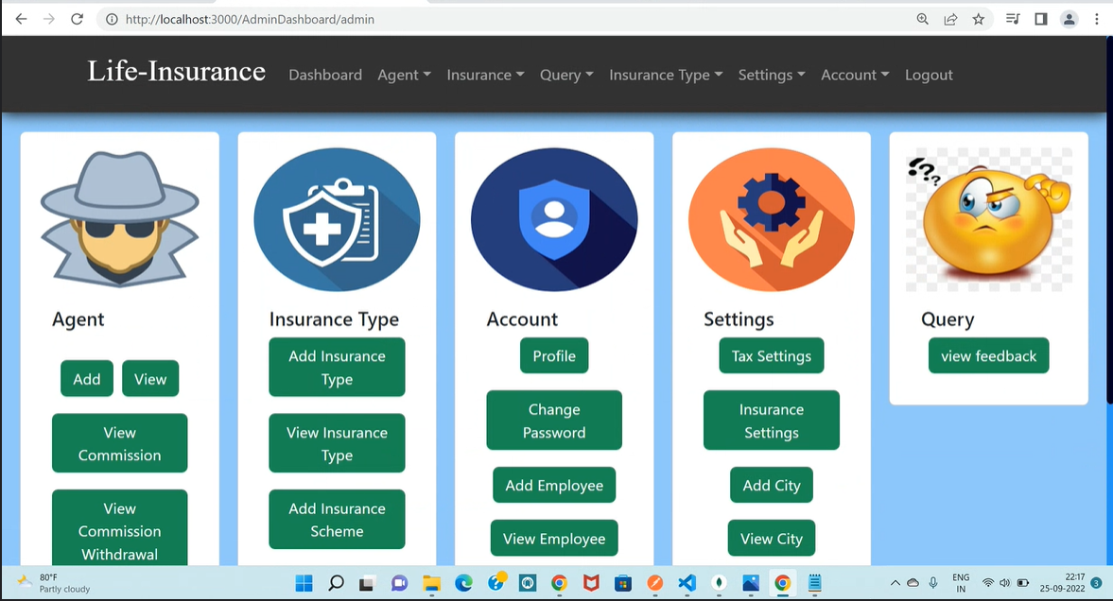
Admin Dashboard

Slide 13
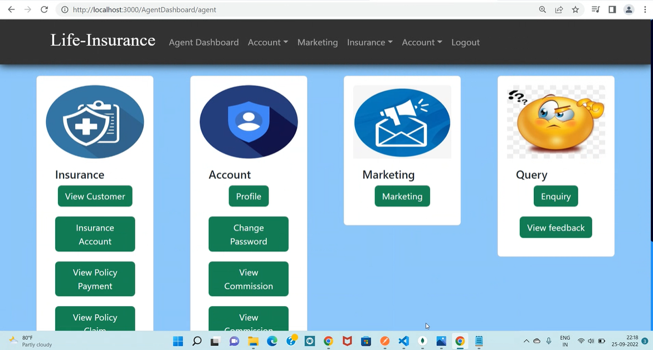
Agent Dashboard

Slide 14
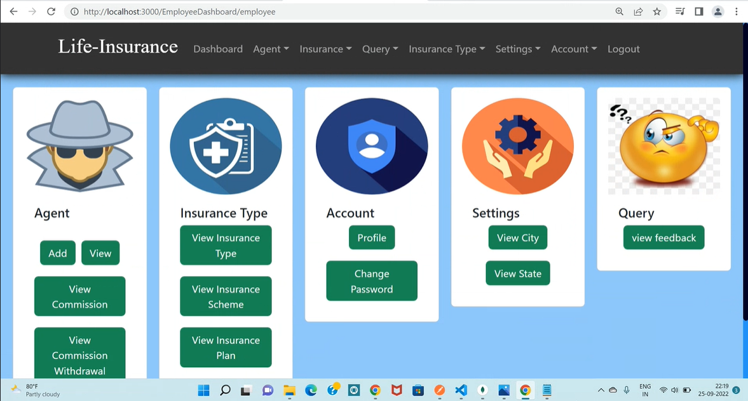
Employee Dashboard

Slide 15

Additional Feature
Agent can send the E-mail to the various clients from the system for the communication or marketing purpose

Slide 16
Thank you!

